Slide 1
D Language
Movie Library Project by Matthew Johnson, Luis Gomez, David Newton, Matthew Smrzlick, and Daniel Cole

Slide 2

Paradigm
Imperative (like C)
Object-Oriented (like C++)
Meta-programming
Functional
Parallel
Concurrency

Slide 3
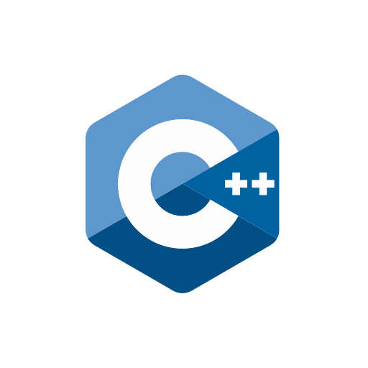

History
Started development in 1999 by Walter Bright
Focused on object-oriented (like C++)
Also focused on meta-programming (like Ruby)
Released in 2001

Slide 4
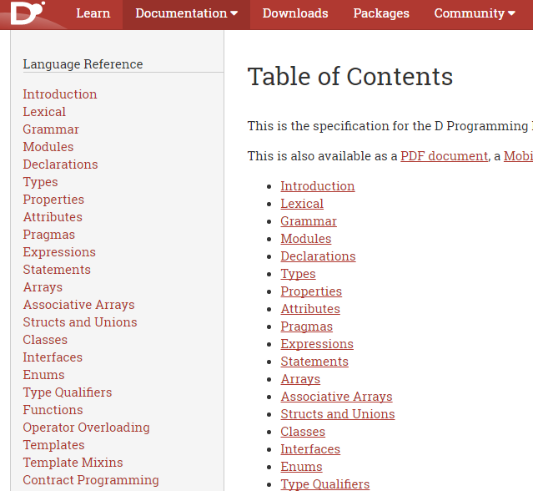
Differences from Other Languages
Keywords from both C and Ruby
Weak Documentation
Backwards compatibility with C and C++

Slide 5
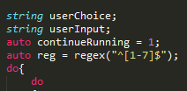
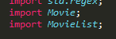
Helpful and Compelling Features
Familiar syntax
Similar to all three of C, C++, and Ruby
Type checking at runtime
Class importation for higher modularity
Regular expression support for error checking

Slide 6
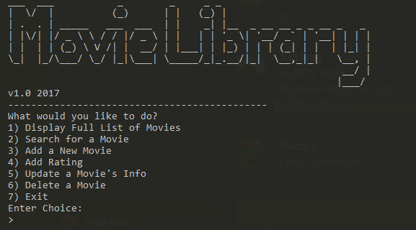
Sample Run

